Slide 1
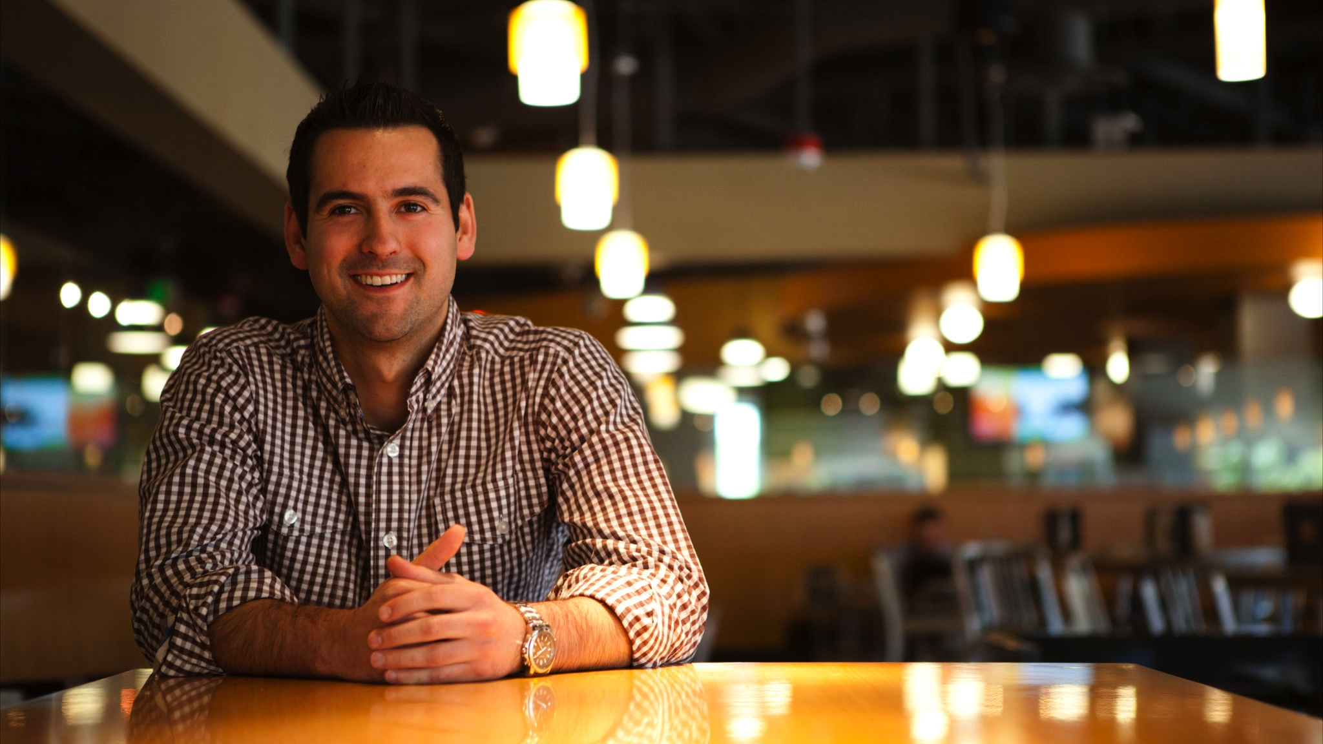

User Story Overview
Samantha Marsh
ITSM Senior Consultant
May 2016

Slide 2
Agenda
Introductions
A Little Background
What are User Stories?
What Do I Do With User Stories?
Writing Good User Stories (Investing)
Estimating and Sizing User Stories
Gathering User Stories
Acceptance Criteria
Misc. Info
Notes:
If this

Slide 3
Introductions

Slide 4
A Little Background…

Slide 5
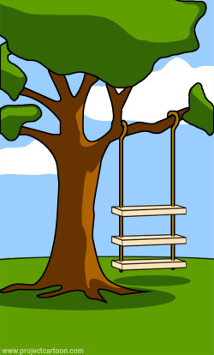
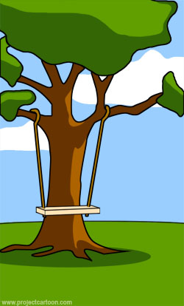
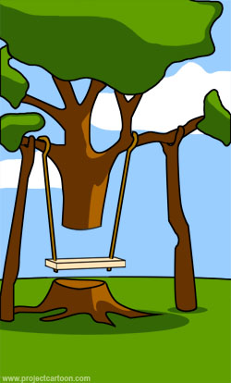
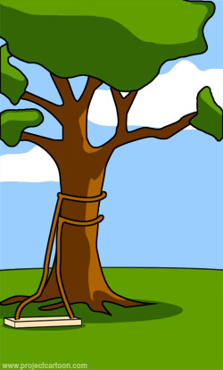
Traditional Project
How the customer explained it
How the Product Manager understood it
How the BA captured requirements
How the Developer wrote the code

Slide 6
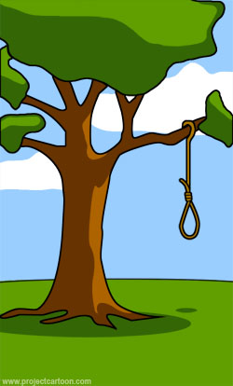
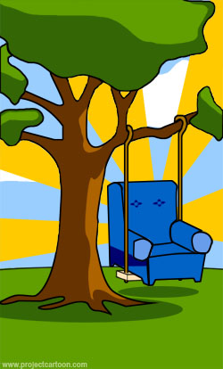

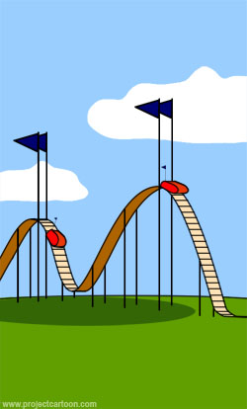
Traditional Project
What QA received
How the Relationship Manager described it
What Release deployed
How the Customer was billed

Slide 7


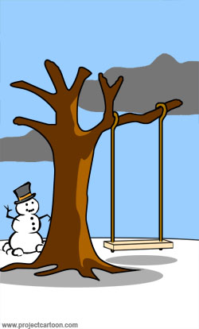
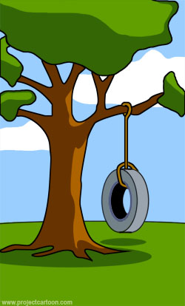
Traditional Project
How the Project was documented
How the Operations supported it
When it was actually delivered
What the Customer really wanted

Slide 8
We Can Agree That
Requirements are not fully understood before a project begins (Ziv’s law)
Users know what they want only after they see an initial version of the software (Humphrey’s law)
Requirements change often during the software construction process (over 60%)
Most software features are rarely or never used (64%)
No matter how much thinking, thinking and thinking you do, you can’t completely specify a non-trivial system up front
Software requirements is a communication problem
Those who want the software must effectively communicate with those who build it
Notes:
y

Slide 9
Software Features Actually Used
Source: 2000 Standish Group study of fortune 500 company software

Slide 10
2 Designs
Empirical Design
The intended users are studied or observed by the designer of the software who then makes all the design decisions
Participatory Design
The intended users of the system become part of the team designing the behavior of the system

Slide 11
User Story Benefits
Emphasize verbal communication
Stories shift the focus from writing to talking
Comprehensible by both customer and developer
Right size for planning
Stories support and encourage iterative development
Encourage deferring detail until you have the best understanding you want to
Encourage participatory design
Stories emphasize the user’s goals not the system’s attributes
User Stories as a requirements process saves time, eliminates rework, and leads to better software

Slide 12
What Are User Stories?

Slide 13
What is a User Story
A user story is a high level software system feature or requirement formulated as one sentence in the everyday language of the user
User Stories are a place holder for a conversation to be held later
User stories are written by the business or Product Owners
User stories are prioritized by the business with the help of the Product Owner to indicate which are most important for the system
Detailed requirements for a User Story are gathered later, closer to when the story is actually implemented
User Stories must include acceptance/test criteria
User Stories can initially be large (called Epics) and broken down later
User stories are a simple, but they are not always easy

Slide 14
What User Stories Are Not
Not Use Cases
Not Scenarios
Not IEEE 830 standard requirements
Not detailed requirements
Not design specs
Not artifacts of analysis, but user desired features in a system

Slide 15
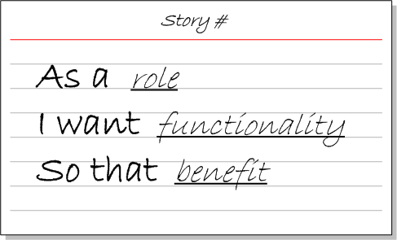
User Story Format
To facilitate the creation of User Stories, a simple format has been developed.

Slide 16
User Story Examples
As a user I need a username and password so that I can be confident my details remain private and I can access secure content.
As a user I want to be able to chose a username when I register so that it can be personalized.
As a user I want to be able to change my default password after I register so that it can be personalized.
As an Administrator I want the system to assign a default a password to a new user so that registration can be automated.
As an Administrator I want the system to send a registration email to a new user so that their email can be confirmed by way of activating their account
As an Administrator I want the system to ask the user to login before they see any secure content so that the security of content is assured.
As a user I want to be able to ask the system for a password reminder so that I don’t need to worry about forgetting my password
As an Administrator I want the system to request memorable information before reminding a user of their password so that the system can be confident the person asking for the reminder is in fact the user

Slide 17
The “User”
Many projects mistakenly assume there’s only one user: “The user”
Write all stories from one user’s perspective
Assume all users have the same goals
Leads to missing stories
Start thinking of software as solving the needs of real people. Instead of “The User”, think of specific roles like:
Agent
Frequent Flyer
Scheduler
Repeat traveler
Administrator
Infrequent Vacation Planner

Slide 18
What do I do with User Stories?

Slide 19
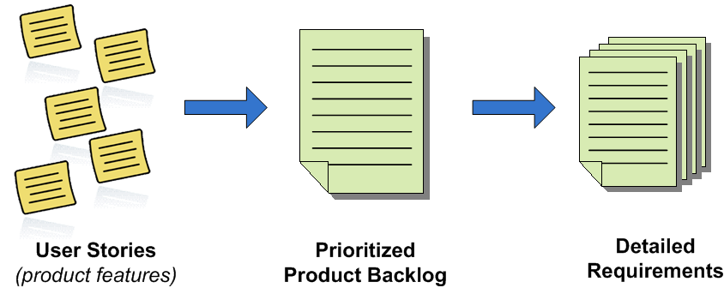
What Do I Do with User Stories?
User stories are collected and prioritized on a list called a product backlog
A small set of stories are selected for delivery and only then are they broken down into detailed requirements
Supporting the concept of “just in time” requirements

Slide 20
Writing Good User Stories

Slide 21
INVEST in User Stories
Independent: | A good story should stand on its own
Negotiable: | A good story is negotiable. It is not an explicit contract for features; rather, details are co-created by the business and delivery team during development. A good story captures the essence not the details.
Valuable: | A user story should be valuable to the business.
Estimable: | The team should be able to gauge the size of a story
Small: | A good rule of thumb is that a user story should be no more …
Testable: | The story should include validation criteria.

Slide 22
INVesting in Good User Stories
Independent
Dependencies lead to problems estimating and prioritizing
Can ideally select a story to work on without pulling in 18 other stories
Negotiable
Stories are not contracts
Leave or imply some flexibility
Valuable
To user or customers, not developers
Rewrite (most) developer stories to reflect value to users or customers

Slide 23
InvESTing in Good User Stories
Estimatable
Because plans are based on user stories, we need to be able to estimate them
Sized Appropriately
Complex stories are intrinsically large
Compound stories are multiple stories in one
Testable
Stories need to be testable

Slide 24
Estimating and Sizing User Stories

Slide 25
Why Size user Stories?
Aid in Prioritization
Size is a ROM (Rough order of Magnitude) NOT an LOE (Level of Effort)
Helps ensure the more important thinks are done first

Slide 26
Sizing and Estimating Methods
Story Points: A relative sizing (not duration) using a series of values of: 0, ½, 1, 2, 3, 5, 13, 20, 40, 100
Shirt Size Method: A common practice in sizing up User Stories is to assign shirt sizes: xs, s, m, l, xl, xxl. This practice allows you to quickly assign an instinctive gut feel of the size of a User Story, which helps when performing a fit check of candidate stories for a Sprint.
Sudoku Sizing. Tag each User Story with one of the following labels: Gentle, Easy, Intermediate, Hard, Diabolical
Having the team estimate individually and average the estimates generally is more accurate

Slide 27
How do I Gather Stories?

Slide 28
Gathering Stories
Gather only high level user stories first
Interviews
Questionnaires
Observation
Story writing workshops
Identify conceptual workflow first
Pick up one user role
Start describing user stories
Pick another user role
Do not debate on whether these are correct user stories or not at this time

Slide 29
Super Simple User Story Method
A simple method of capturing requirements as User Stories:
5 step process . . .
Identify, clarify and write down the business process being modeled
Identify the actors involved in the business process
Brainstorm the actions each actor takes during the business process
Develop a use case diagram
Write user stories from use case diagram

Slide 30
Define the Business Process
Eat a meal at a restaurant

Slide 31
Defining the Actors Involved in the business process
Patron
Waiter
Chef
Cashier

Slide 32
Determine actions each actor takes during the process
Order Food
Order Food
Eat Food
Serve Food
Pay for Food
Patron
Waiter
Prepare Food
Pay for Food
Cashier
Chef

Slide 33
Determine actions each actor takes during the process
SYSTEM
Order Food
Patron
Serve Food
Waiter
Prepare Food
Eat Food
Pay for Food
Chef
Cashier

Slide 34
Write the User Stories
As a Patron, I would like to order some food so I can eat it
As a Waiter, I would like to take an order from the patron so the Chef can prepare the food
As a Chef, I would like to prepare food for the order that was placed so it can be served to the patron
As a Cashier, I would like to accept payment for the food that was ordered and eaten
As a Patron, I would like to eat the food that was served so I am no longer hungry
As a Waiter, I would like to serve the prepared food to the patron so they can eat it
As a Patron, I would like to pay for the food I ordered and ate so I don’t get arrested

Slide 35
Acceptance Criteria

Slide 36
Acceptance Testing User Stories
User stories should include acceptance criteria that define when a user story has been correctly implemented.
Acceptance tests express many details that result from the conversations between customers and developers
Customer and product owners specify the tests
Customer works with testers
Often responsibility is shared between product manager and tester

Slide 37
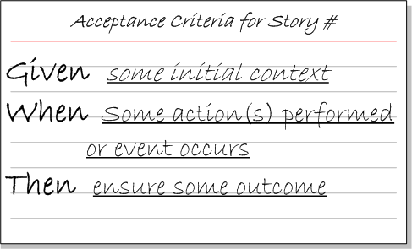
User Story Acceptance Criteria
As with User Stories, acceptance criteria can be captured using a simple format.

Slide 38
Acceptance Criteria Examples
User Story | As an Account Holder I want to withdraw cash from an ATM So that I can get money when the bank is closed
Acceptance Criteria | Scenario 1: Account has sufficient funds Given the account balance is $100 And the card is valid And the machine contains enough money When the Account Holder requests $20 Then the ATM should dispense $20 And the account balance should be $80 And the card should be returned
 | Scenario 2: Account has insufficient funds Given the account balance is $10 And the card is valid And the machine contains enough money When the Account Holder requests $20 Then the ATM should not dispense any money And the ATM should say there are insufficient funds And the account balance should be $20 And the card should be returned
 | Scenario 3: Card has been disabled Given the card is disabled When the Account Holder requests $20 Then the ATM should retain the card And the ATM should say the card has been retained
 | Scenario 4: The ATM has insufficient funds ……

Slide 39
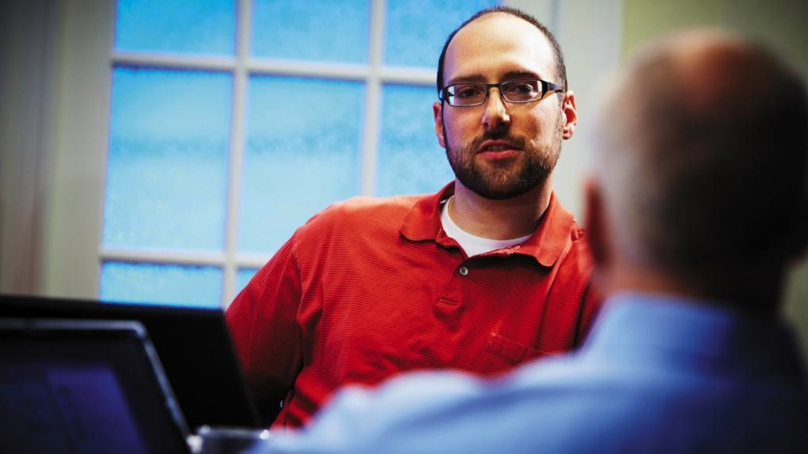
Contact
Samantha Marsh
ITSM Senior Consultant
samarsh@microsoft.com
www.microsoft.com/microsoftservices
© 2013 Microsoft Corporation. All rights reserved. Microsoft, Windows, Windows Vista and other product names are or may be registered trademarks and/or trademarks in the U.S. and/or other countries. The information herein is for informational purposes only and represents the current view of Microsoft Corporation as of the date of this presentation. Because Microsoft must respond to changing market conditions, it should not be interpreted to be a commitment on the part of Microsoft, and Microsoft cannot guarantee the accuracy of any information provided after the date of this presentation. MICROSOFT MAKES NO WARRANTIES, EXPRESS, IMPLIED OR STATUTORY, AS TO THE INFORMATION IN THIS PRESENTATION

Slide 40
Misc. Info
Reading Material:
‘User Stories Applied’ by Mike Cohn
www.userstories.com
www.mountaingoatsoftware.com

